Slide 1
Meticulous Planning Of Test Automation

Slide 2
Agenda
Test Automation Frameworks & Applications Stack
Test Automation Problems
Revisit Test Automation
Introspect Technological Evolution
Introspect Automation Evolution
Precise Testing Approach
Test Automation Solutions
Comparison of Licensed vs Open Source Solutions
Q & A

Slide 3

Test Automation Frameworks & Applications Stack
^{Record & Play (Linear)}
^{Keyword Driven (Sophisticated)}
^{Data Driven (Sophisticated)}
Behavior Driven (Sophisticated)
^{Model Driven (Script less)}
UI
Web
Tibco MQ
Storage
Mobile Web
Mobile App (iOS, Android)
Redis Cache
GCS
Kafka
IBM MQ
Active MQ
Rabbit MQ
SFCC
SFSC
SAP
AEM
AWS
ESB
Database
Oracle
MySQL
DB2
Big Query
Spanner
Mongo
PostgreSQL
API
Restful
Soap
Aerospike
Cassandra
Manual Testing

Slide 4
Test Automation Problems
Defects slipping into UAT & Production are irrespective of…
Product Type
Application Type
Testing Type
Industry Type
Technology Type
Test Framework
Hardware Resource
Human Resource
Process / Methodology
Scripts Maintenance & Optimization
Data & Environment
Scripts Volume
Execution Volume
Reporting
Failure Triage
Design & Coverage

Slide 5
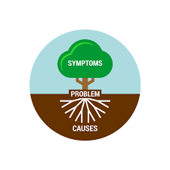


Revisit Test Automation
Shorter Release Cycle ? | X | Poor Test Planning ? | X
System Complexity ? | X | Time & Budget ? | X
Testers Ability ? | X | Tests Efficiency & Effectiveness ? | X
DevOps Support ? | X | Doing Things In Right Way ? | X
Choice of Tools/Technologies ? |  | Doing Right Things ?
“We didn’t do anything wrong
but somehow, we lost”
~ Stephen Elop, CEO, Nokia
Question: What's the problem & how to solve?
Answer: 1st Step is to accept that we have problem ☺

Slide 6





Introspect Technological Evolution
Do we need of AI/ML now?
Otherwise we need AI only because…
- We are ambitious & dreaming to create human intelligence
- We can do it, so simply we have to do it ☺
- We don't need AS, we have enough of it ☺
To guarantee quality beyond certain level of speed & complexity –
Need of AI/ML
Guarantee quality with rise of technical complexity & reduction in delivery cycle – Continuous Testing
"Before we work on AI, why don't we do something about natural stupidity“
~ Steve Polyak

Slide 7
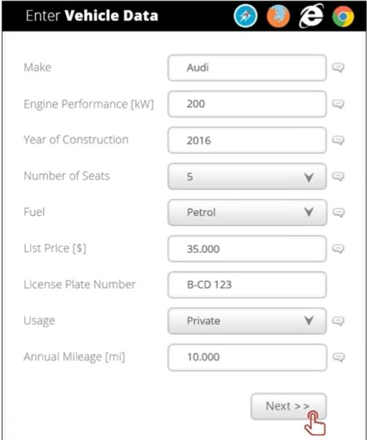
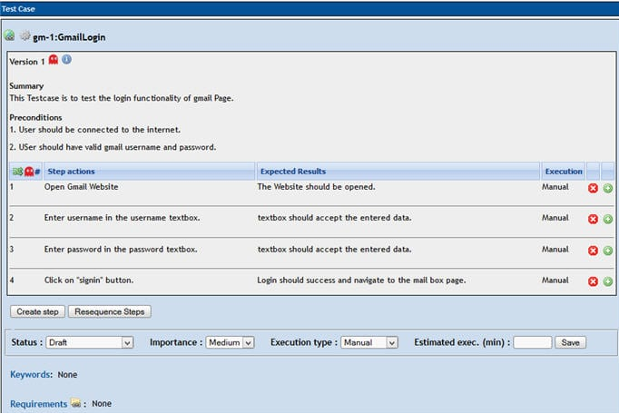
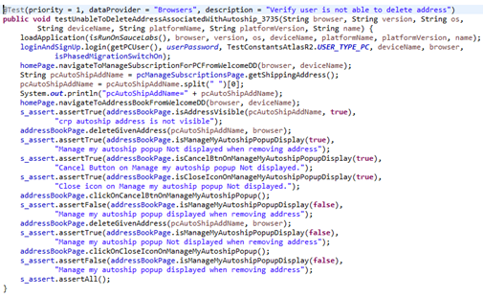
Introspect Automation Approach – TDD
Doing Right Things?
Loosely Coupled | Hazy
Test Driven | Script Based
Business
Test Code
Test Case

Slide 8
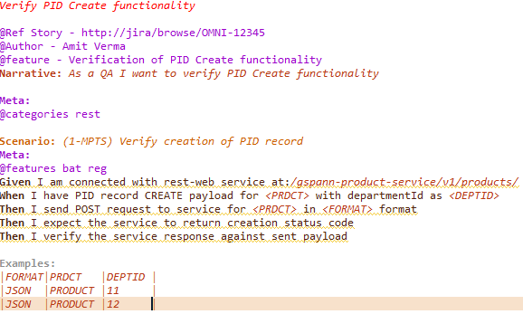
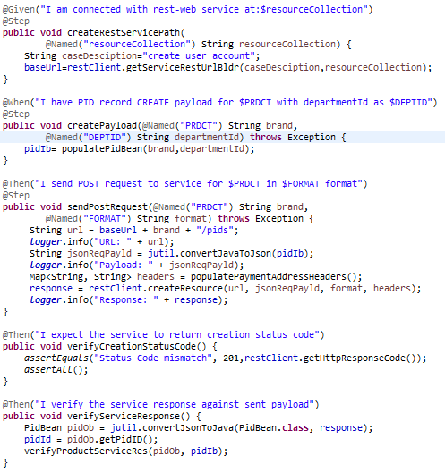
Introspect Automation Approach – BDD
Doing Right Things?
Tightly Coupled | Pellucid
Behaviour Driven | Script Based
Business
Test Case
Test Code

Slide 9
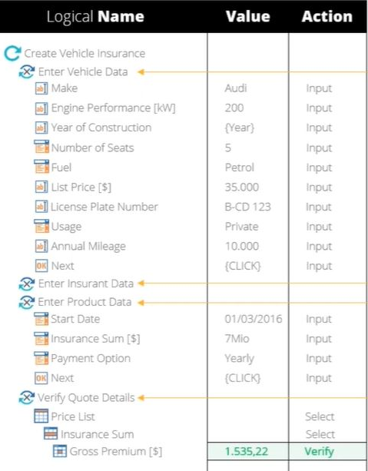
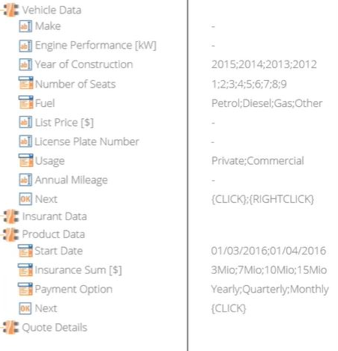
Introspect Automation Approach – MD
Doing Right Things?
Tightly Coupled | Lucid
Model Driven | Script Less
Model
Business
Test Case

Slide 10
Precise Testing Approach?
Design→ Visualize functional flow in pictorial form i.e. model?
Coverage→ Auto generate test, data combinations?
Stability→ Handle flakiness?
Optimization→ Maximize reusability?
Excellent Visuals
Best Understanding
Better Testing
Good Quality
Lower Risk
Covering AC is enough?
Solution for End to End automation?
Introspection
Methodical Test design
Tester Focus
Reduce Maintenance Time
Testing Focus AUT → SUT
Exploratory Testing
Increase Test Efficiency & Effectiveness
Risk Based Testing
Design, Implement, Execute as per risk weightage?
Risk Assessment?
Risk Reporting?
Scan and Fix Quickly?
Intuitive is good for exploratory testing?
Script Creation & Execution only !
Notes:
SUT→ UI fine, Service fine, but still defect in workflow because of integration issues with downstream systems
i.e. All App-type of testing modules should be bundled together to develop system tests
Maximize risk coverage→ Identify and align weightage on major component of system which can cause business impact
e.g. Engine, feature, body
e.g. Search, Account, PDP, Pricing, Offers, Wallet, Loyalty, Add-To-Bag, Place Order, Cancel/Update Order, Order History/Details, Order Tracking etc.
Test efficiency & effectiveness depends on testers technical & analytical abilities→ Provide tools/solutions to tester which help them on Design, Coverage, Stability, Optimization so that he can focus on script creation & execution only

Slide 11
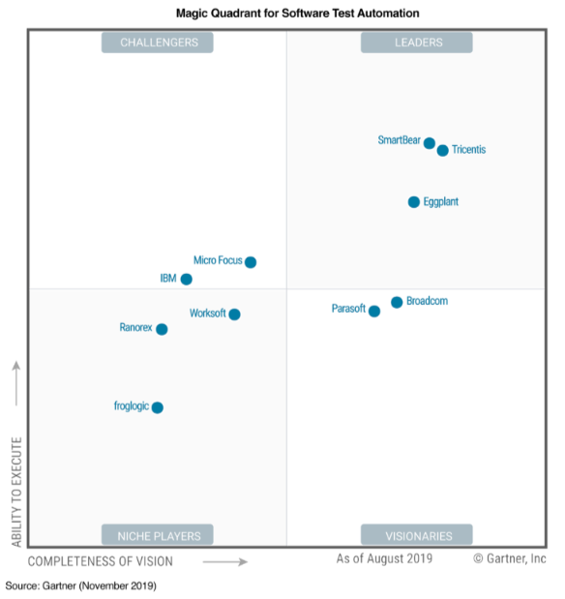
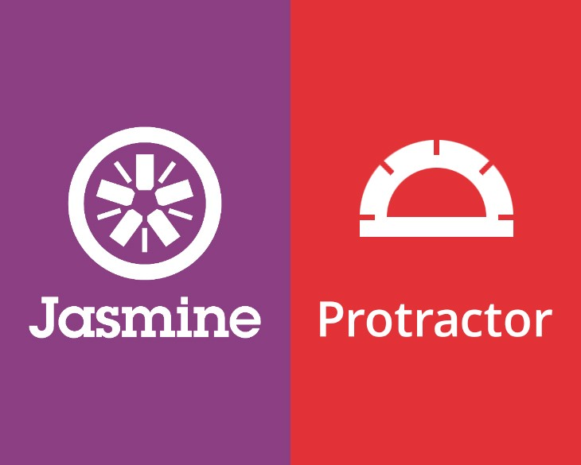







Introspect Test Automation Solutions – Market Leaders
Notes:
SUT→ UI fine, Service fine, but still defect in workflow because of integration issues with downstream systems
i.e. All App-type of testing modules should be bundled together to develop system tests
Maximize risk coverage→ Identify and align weightage on major component of system which can cause business impact
e.g. Engine, feature, body
e.g. Search, Account, PDP, Pricing, Offers, Wallet, Loyalty, Add-To-Bag, Place Order, Cancel/Update Order, Order History/Details, Order Tracking etc.
Test efficiency & effectiveness depends on testers technical & analytical abilities→ Provide tools/solutions to tester which help them on Design, Coverage, Stability, Optimization so that he can focus on script creation & execution only

Slide 12
Test Automation Solutions: Licensed Vs Open Source
Testing Stack Support
Parameter |  | Open Source
SQL DB Testing | 3 | 3
Cross Browser Testing | 3 | 3
Dedicated Platforms Support- SFSC, SAP | 3 | 2
Dedicated Platforms Support- AEM | 2 | 2
Cloud Integration | 2 | 3
Parallel Execution Of Test Builds/Suites | 3 | 3
Mobile Web Testing | 3 | 2
Mobile App Testing (iOS, Android) | 2 | 2
Test Case Design | 3 | 2
Test Data Management | 3 | 2
E2E Testing | 2 | 3
Restful & SOAP API Testing | 3 | 3
CI Support | 2 | 3
Web UI Testing - General Elements | 3 | 3
Web UI Testing - Tables, Upload File, Tab/Window, Clipboard Elements | 3 | 2
Web UI Testing - Radio Button, Textbox Cum Dropdown Elements | 3 | 2
BI/DWH Testing | 3 | 2
Soft vs Hard Assertions | 1 | 3
Storage Systems Testing | 1 | 3
Desktop UI Testing | 3 | 1
Exploratory Testing | 3 | 1
Email Activation via Mailbox | 1 | 3
3rd Party Services Mocking | 1 | 3
No SQL DB Testing | 1 | 3
Cross Platform Testing - Sauce labs | 1 | 3
Cross Platform Testing - Device labs | 1 | 3
Framework / Tool Platform Dependency | 1 | 3
Image Pixels Testing | 2 | 1
Parallel Execution Of Test Cases Within Build/Suite | 0 | 3
CD Support | 0 | 3
ESB Testing | 0 | 3
Caching Systems Testing | 0 | 3
PDF Data Testing | 3 | 0
No Support | 0
Limited Support | 1
Good Support | 2
Excellent Support | 3

Slide 13
Test Automation Solutions: Licensed Vs Open Source
Technical Resource Competencies
Parameter |  | Open Source
Web UI App | Tool | Selenium, X Path, CSS Path, Other Locators
Build Life Cycle | Tool | Ant, Maven, Gradle
Source Code Version Control | Tool | Git, SVN, TFS, CVS
Programming Language | Tool | Java, Python, C#, Java Script
Deployment Life Cycle | Tool + CI Tool | Jenkin, Bamboo, Cruise Control
Test Reporting | Tool | Xunit, Allure, Extent
Java Test Runners | Tool | Junit, TestNG, Cucumber, J-Behave
JS Test Runners | Tool | Mocha, Protractor, Jasmine, Karma
Test Assertions | Tool | Hamcrest, AssertJ, Junit, TestNG, Chai
Test Case Management | Tool | Test Link, Test Rail, QTest, QMetry
Test Data Management | Tool | XLS, CSV, XML, JSON, Property File
Rest API's | Tool | HTTP Client, Rest Easy/Assured, Sprint Boot
SOAP API's | Tool | WSDL, JAXB
Mobile App | Tool + Appium | Appium, Calabash
Desktop UI App | Tool | WinAppDriver, Winium, TestStack.White, Pywinauto
Images | Tool | Ashot, Resemble.js
SQL Database | SQL Query | Oracle, MySQL, DB2, PostgreSQL, Spanner, MS-SQL
PDF Data | Tool | NA
Caching Systems | NA | Redis
Delivery Life Cycle | NA | Docker, Tonomi
ESB | NA | Tibco, ActiveMQ, RabbitMQ, IBM MQ, Kafka
DWH / Storage Systems | NA | GCS, Big Query
Non SQL Database | NA | Mongo, Scylla
Test Execution | NA | Sauce Labs, Device Labs

Slide 14
Test Automation Solutions: Licensed Vs Open Source
Business Aspects
Parameter |  | Open Source
Automation Type | Model Based | Code Based
Required Skill Level | Moderate | High
Script Building Cost | Low | High
Test Scripts Maintenance Effort | Low | High
Test Data Reusability | High | Medium
Test Artefacts Reusability | High | High
Adoption Ease | Very High | Low
Test Script Build Time-High Complexity | 50-60% | 100%
Test Script Build Time-Medium Complexity | 40-45% | 100%
Test Script Build Time-Low Complexity | 30-35% | 100%
Ease Of Automation | High | Medium
On-Premise & Distributed Support | Yes | Yes
Test Scripts Optimization Effort | Medium | High
Framework / Tool Cost | $$$ | $
Scalability | Low | High
Dedicated Support | High | Medium
Forum Support | Low | High

Slide 15
Q & A
Thank You

